Slide 1

Game data analysis using mysql
Shahriar alam

Slide 2

Agenda
Introduction
Summary

Slide 3

Introduction
Table: player_details
Columns:
P_ID int PK
PName text
L1_Status varchar(30)
L2_Status varchar(30)
L1_Code text
L2_Code text
Table: level_details2
Columns:
P_ID int PK
Dev_Id varchar(10)
start_datetime datetime
Stages_crosed int
Level int
Difficulty varchar(15)
Kill_Count int
Headshots_
Count int
Score int
Lives_Earned int

Slide 4
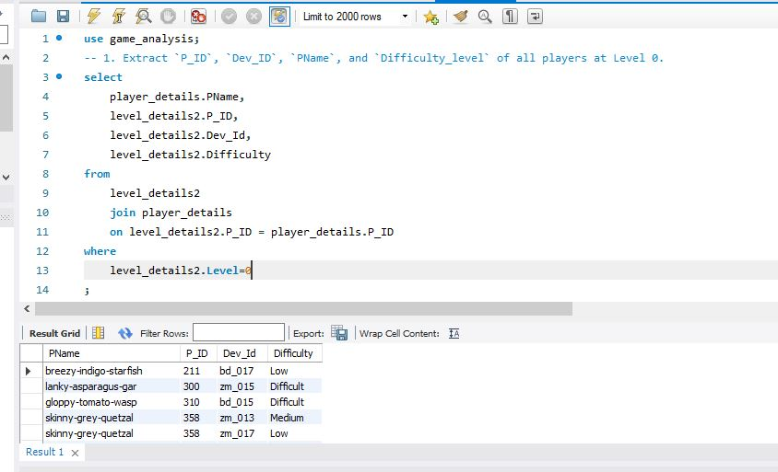

Explanation:
This Sql Query Retrieves Information About Players Who Are At Level 0. It Selects The Player Id (P_Id), Device Id (Dev_Id), Player Name (Pname), And Difficulty Level (Difficulty_Level). To Obtain The Player Name, It Joins The Level_Details2 Table With Another Table (Assuming Named Players_Table) That Contains Player Names Based On Their Ids (P_Id). Finally, It Filters The Results To Include Only Records Where The Player'S Level Is 0.

Slide 5
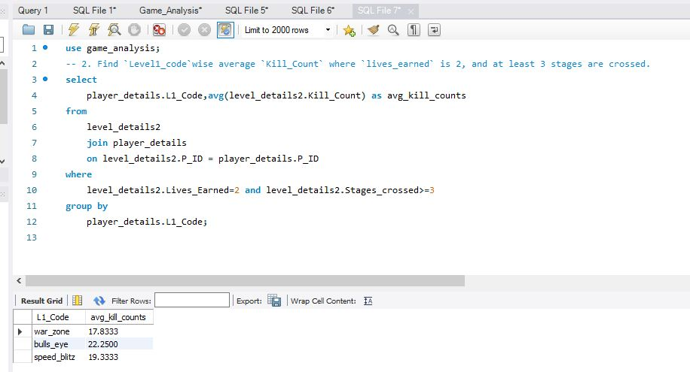
Explanation:
This SQL query calculates the average Kill_Count for each Level1_code from the level_details2 table, joined with the player_details table. It filters the data based on the conditions where Lives_Earned is 2 and at least 3 stages are crossed. Finally, it groups the results by Level1_code and computes the average Kill_Count for each group.

Slide 6
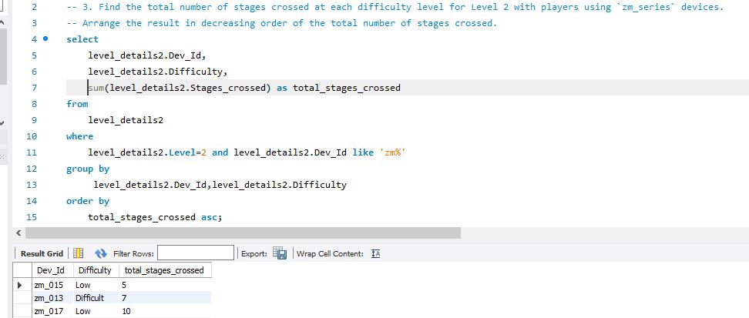
Explanation:
This SQL query calculates the total number of stages crossed at each difficulty level for Level 2 with players using zm_series devices. It filters the data to include only entries where the level is 2 and the device ID starts with 'zm'. Then, it groups the data by Dev_Id and Difficulty, summing the Stages_crossed for each group. Finally, it arranges the result in descending order based on the total number of stages crossed, providing insights into the distribution of stage progression among different difficulty levels for Level 2 players with zm_series devices.

Slide 7
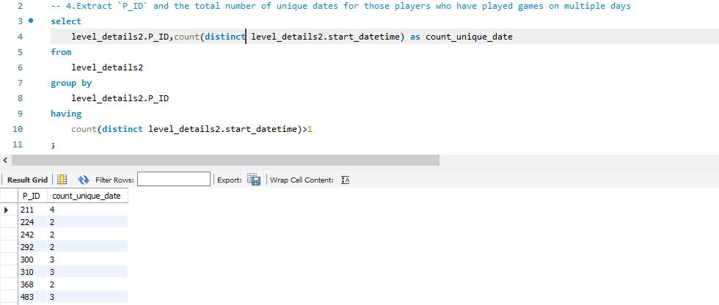
This SQL query retrieves the player ID (P_ID) and calculates the total number of unique dates on which each player has played games. It groups the data by P_ID and counts the distinct start_datetime values for each player. Then, it filters the results to include only players who have played games on more than one date. This provides insights into players who have engaged with the game on multiple days.

Slide 8
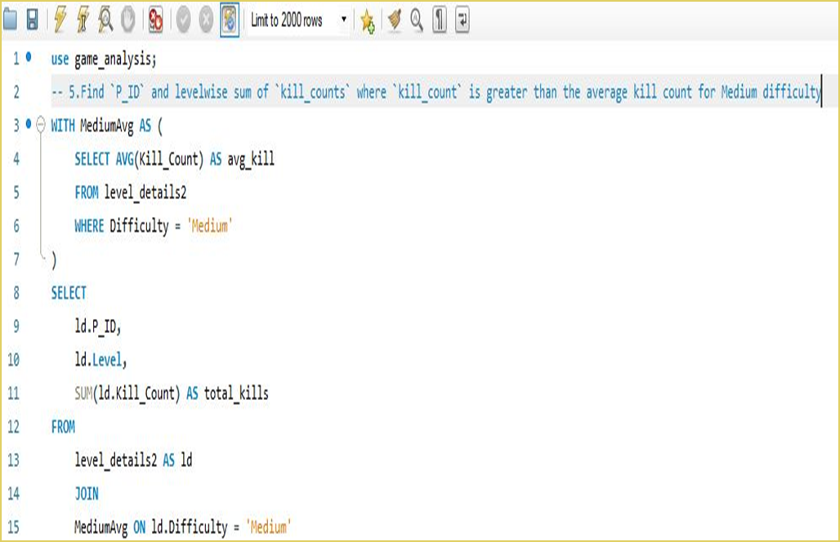
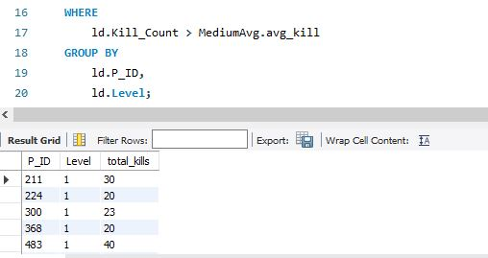
In this query, it calculates the average kill count for the Medium difficulty level using a Common Table Expression (CTE) named MediumAvg. Then, it selects the player ID (P_ID), level (Level), and the sum of kill counts (total_kills) from the level_details2 table, joining it with the MediumAvg CTE on the condition that the difficulty is Medium.
Finally, it filters the results to include only rows where the kill count is greater than the average kill count for Medium difficulty and groups the data by P_ID and Level. This provides insights into players who have achieved kill counts surpassing the average for Medium difficulty, organized by player ID and level.

Slide 9
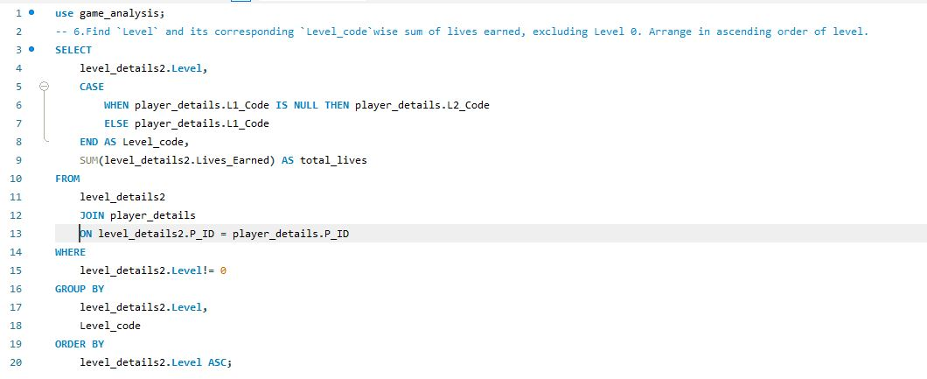
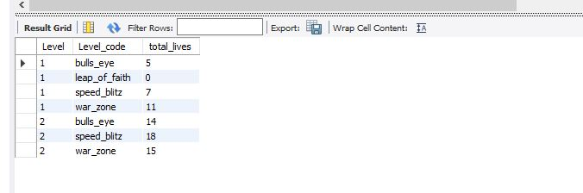
This SQL query retrieves the sum of lives earned (total_lives) for each Level, grouped by its corresponding Level_code, excluding Level 0.It utilizes a CASE statement to determine the Level_code based on whether the player has a Level 1 code (L1_Code) or a Level 2 code (L2_Code).The results are ordered in ascending order of Level, providing insights into the total lives earned for each level, categorized by its corresponding level code.

Slide 10
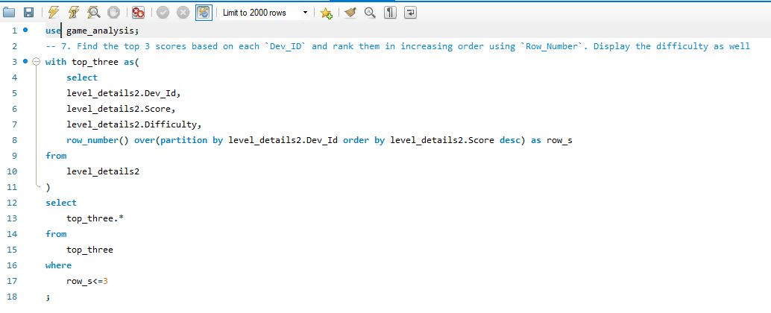
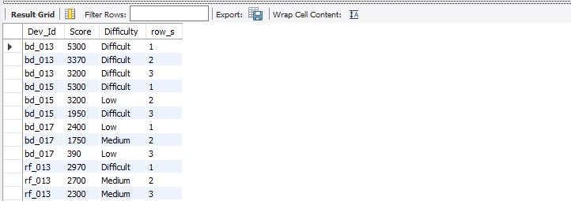
This SQL query retrieves the sum of lives earned (total_lives) for each Level, grouped by its corresponding Level_code, excluding Level 0.It utilizes a CASE statement to determine the Level_code based on whether the player has a Level 1 cThis SQL query utilizes a Common Table Expression (CTE) named top_three to select the Dev_Id, Score, and Difficulty from the level_details2 table. Within this CTE, the ROW_NUMBER() window function assigns a rank to each row within each Dev_Id partition, ordering them by score in descending order . The main query then selects from the top_three CTE, filtering only the rows where the rank is less than or equal to 3. This effectively retrieves the top 3 scores based on each Dev_Id, along with their corresponding difficulty levels.ode (L1_Code) or a Level 2 code (L2_Code).The results are ordered in ascending order of Level, providing insights into the total lives earned for each level, categorized by its corresponding level code.

Slide 11
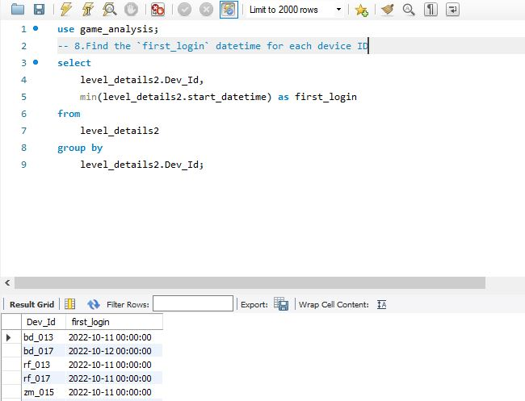
This SQL query retrieves the earliest login datetime (first_login) for each device ID (Dev_Id) from the level_details2 table. It uses the MIN() function to find the minimum start_datetime for each device ID and groups the results by Dev_Id. The output provides insights into when each device ID was first used to log in.

Slide 12
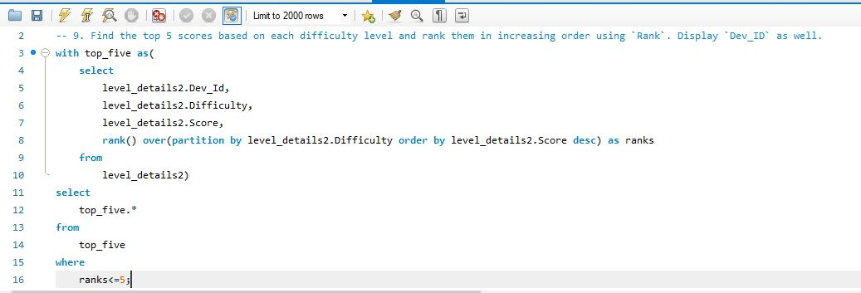
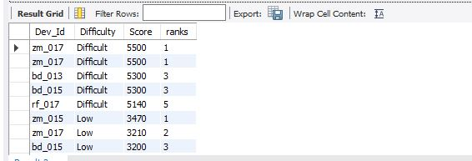
This SQL query utilizes a Common Table Expression (CTE) named top_five to select the Dev_Id, Difficulty, and Score from the level_details2 table. Within this CTE, the RANK() window function assigns a rank to each row within each difficulty level partition, ordering them by score in descending order.
The main query then selects from the top_five CTE, filtering only the rows where the rank is less than or equal to 5. This effectively retrieves the top 5 scores for each difficulty level, along with their corresponding device IDs (Dev_Id).

Slide 13
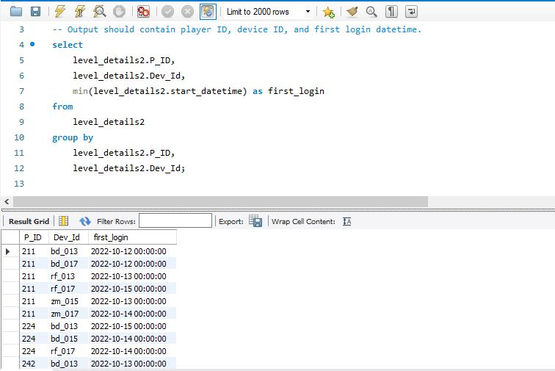
This SQL query retrieves the earliest login datetime (first_login) for each player (P_ID) along with the corresponding device ID (Dev_Id). It uses the MIN() function to find the earliest start_datetime for each combination of player ID and device ID, grouping the results accordingly. The output provides insights into when each player first logged in and on which device.

Slide 14
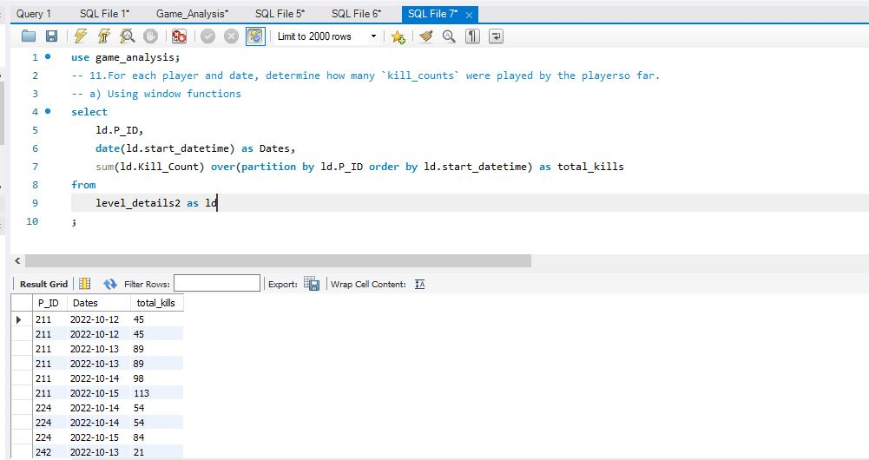
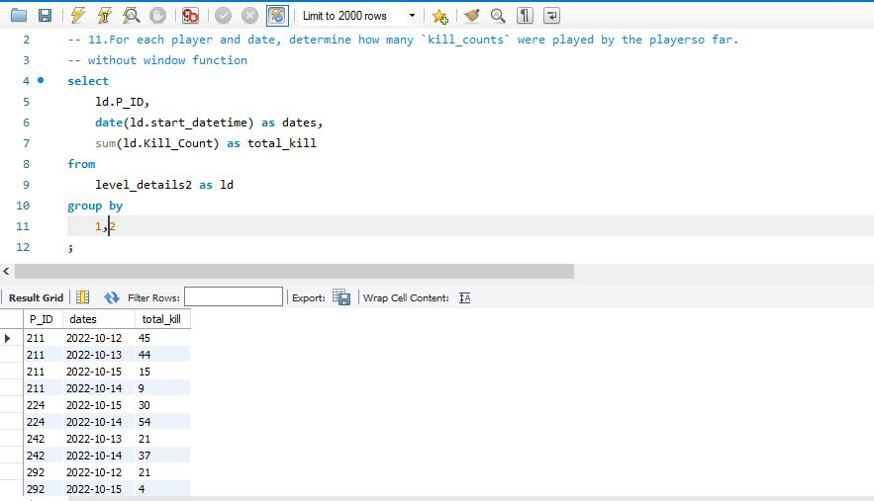
The first query utilizes window functions to calculate the cumulative sum of kill_counts for each player (P_ID) ordered by start_datetime. This provides a running total of kills for each player across all dates.
The second query achieves the same result without using window functions. Instead, it calculates the sum of kill_counts for each player on each date by grouping the data by P_ID and the date extracted from start_datetime.

Slide 15
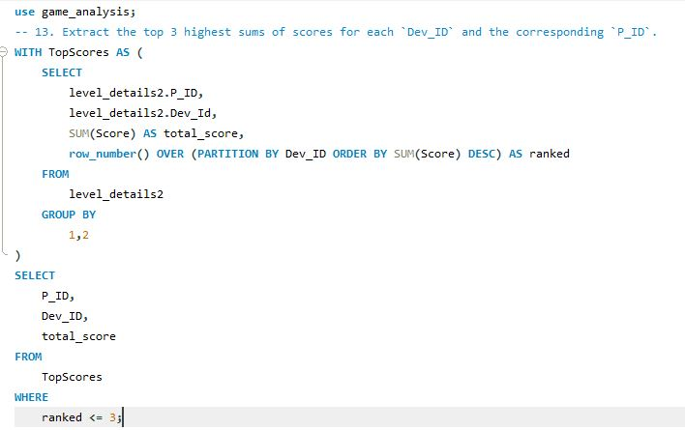
This SQL query utilizes a Common Table Expression (CTE) named TopScores to calculate the total score for each combination of P_ID and Dev_ID, and assigns a rank to each row within each Dev_ID partition based on the total score in descending order.
The main query then selects the P_ID, Dev_ID, and total score from the TopScores CTE, filtering only the rows where the rank is less than or equal to 3. This provides the top 3 highest sums of scores for each Dev_ID along with their corresponding P_ID.

Slide 16
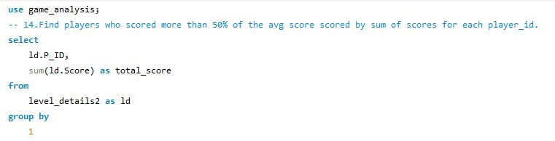
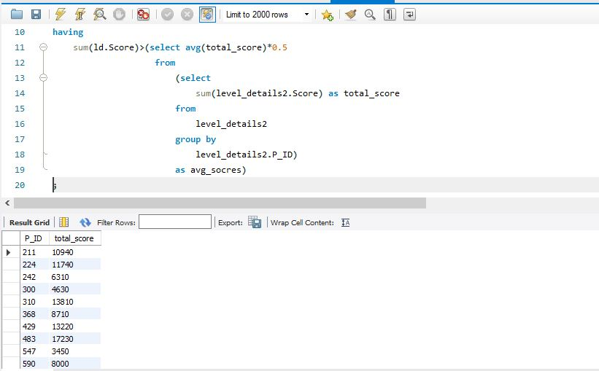
This SQL query retrieves players who scored more than 50% of the average score achieved by all players. It calculates the total score for each player and compares it to half of the average score. If a player's total score exceeds this threshold, they are included in the result set.

Slide 17
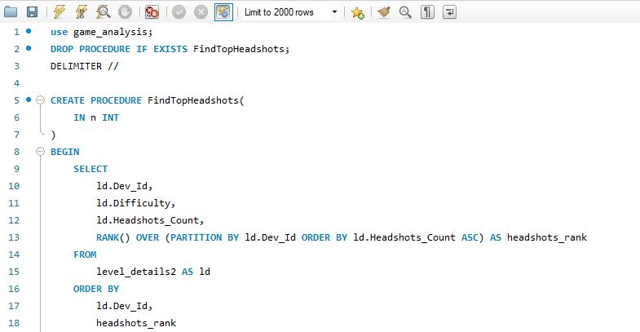
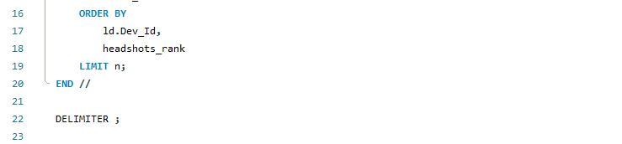
This stored procedure, named FindTopHeadshots, accepts an integer parameter n, representing the number of top headshots_count to retrieve for each Dev_ID. It retrieves the Dev_Id, Difficulty, and Headshots_Count from the level_details2 table, calculates the rank of each Headshots_Count within its Dev_ID partition using RANK(), and then filters the results to include only rows where the headshots_rank is less than or equal to n. This procedure allows users to find and rank the top n headshots_count for each Dev_ID, providing valuable insights into player performance.

Slide 18


Thank you
Shahriar alam

